Slide 1
Veeam Software
Realize the promise of virtualization
David Berney
Channel Manager Southwest
Notes:
11032012

Slide 2

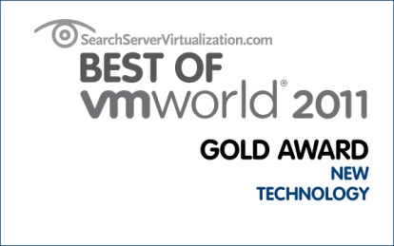
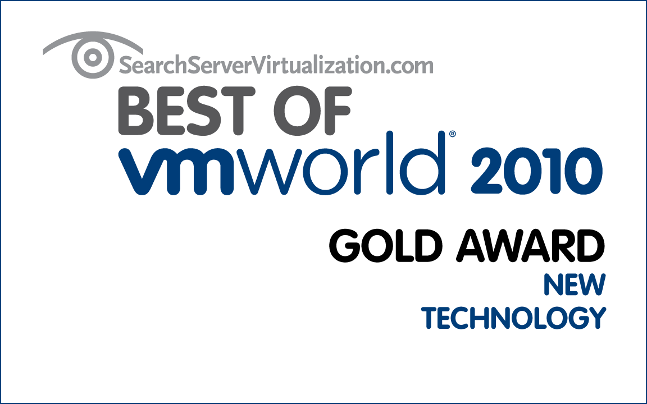
Notes:
Chances are, you’ve heard of Veeam
Best New Technology at VMworld for 2 years in a row
Most VMworld awards ever (8—twice as many as the next closest vendor)
This is Veeam Backup & Replication and Veeam ONE…

Slide 3



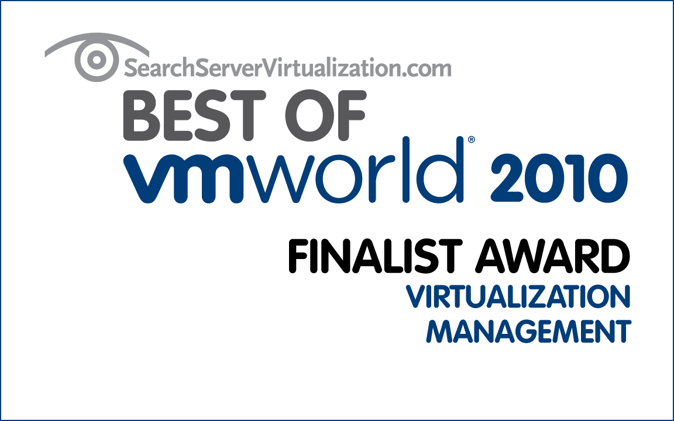
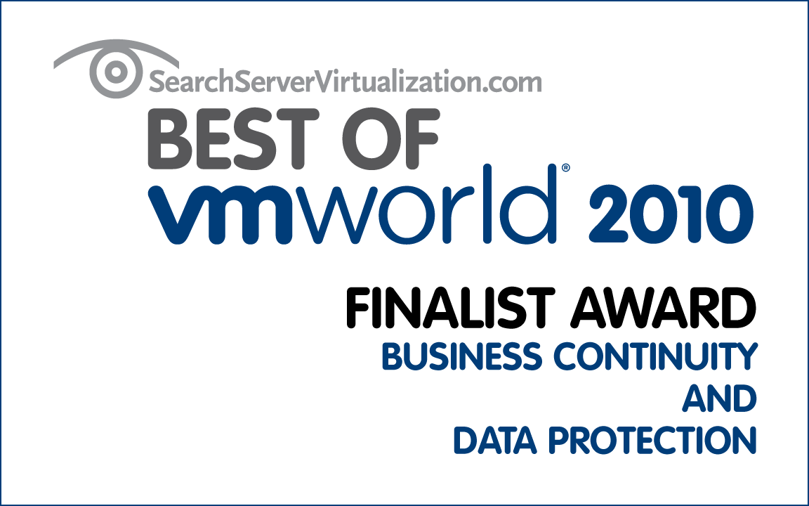
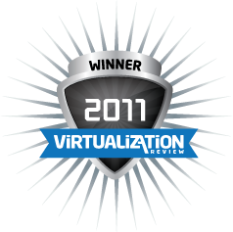
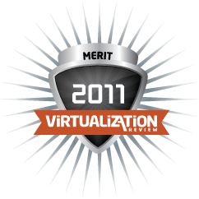

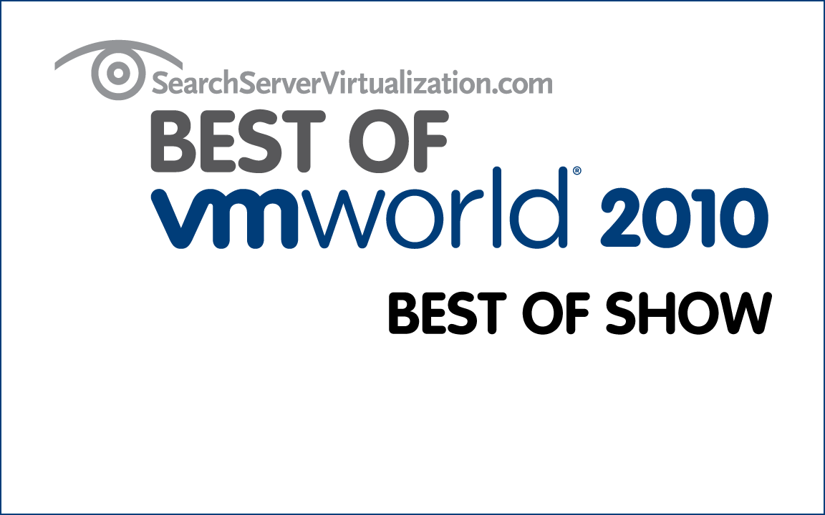
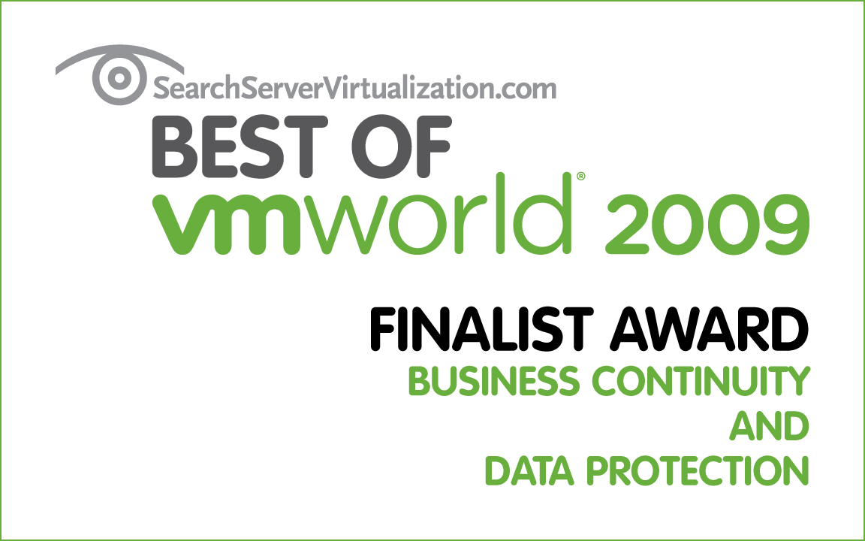



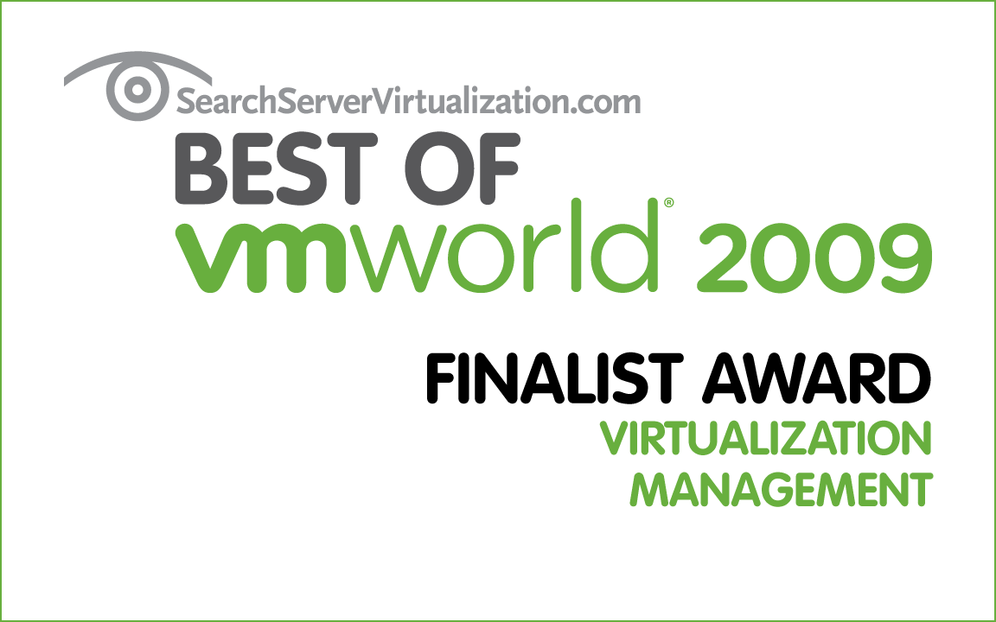

Awards
•

Slide 4

Veeam’s Mission
Virtualization Management

Slide 5
Explosive growth
42,000+ customers
1,500+ new customers per month
170,000+ VMware admins use Veeam® FastSCP™
+86%
+124%
+146%
+136%
+129%
2007
2008
2009
2010
2011
2012
(forecast)
•
Notes:
Chances are, you know someone who uses Veeam products
30,000+ are paying customers
Not only do we have a lot of customers, we have a lot of HAPPY customers…

Slide 6

















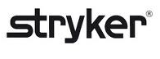
Sample Veeam customers

Slide 7
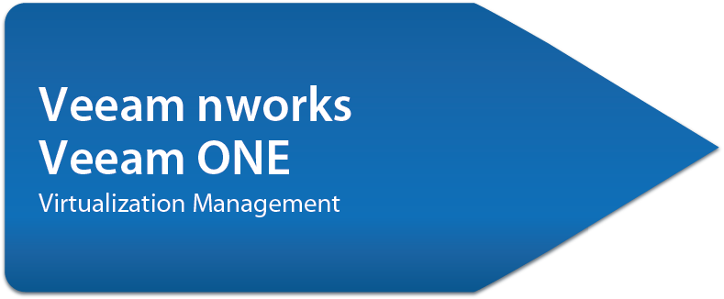

Veeam solutions
•

Slide 8
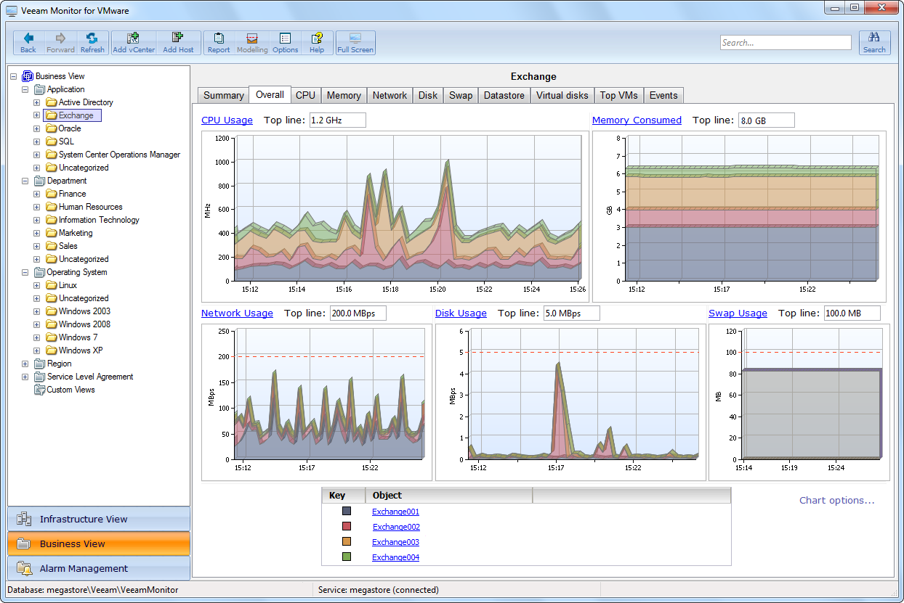
Veeam One
Monitoring
Capacity Planning
Change Management
Reporting & Showback

Slide 9
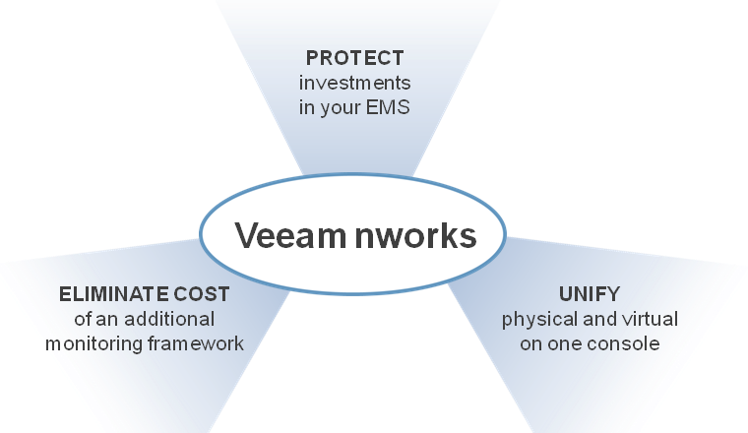
Veeam nworks
Extend enterprise monitoring to VMware vSphere
Veeam nworks Management Pack™ for Microsoft System Center Operations Manager
Veeam nworks Smart Plug-in™ for HP Operations Manager
Notes:
This is the 1st of the 3 offerings
EMS = enterprise monitoring system
Investments include people (training, know-how), processes (including standardization and policies built around your EMS), technology

Slide 10
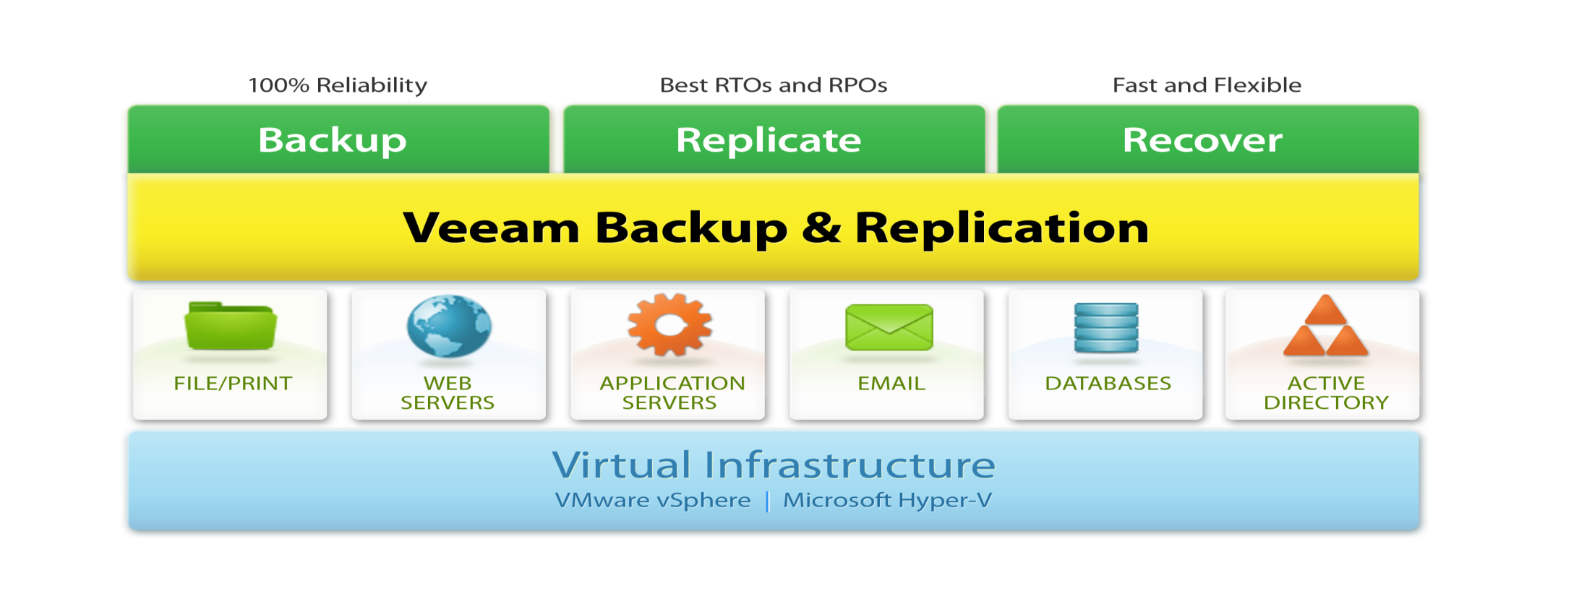
Veeam Backup & Replication
U-AIR
Auto Failover & Failback
SureBackup
Virtual Labs
Notes:
Give quick overview of total product

Slide 11
It’s not about backup, it’s about recovery
Backup is easy, recovery is hard

Slide 12
Your backups are only as good as your restores!
Questions?
Thank you

